Slide 1

DATA MODELS – Chapter 2
Source:-
Database Systems: Design, Implementation, and Management, Eighth Edition
by Peter Rob and Carlos Coronel

Slide 2
Data Model
DATA MODELS
Data modeling, the first step in designing a database, refers to the process of creating a specific data model for a determined problem domain. (A problem domain is a clearly defined area within the real world environment, with well defined scope and boundaries, that is to be systematically addressed.)
A data model is a relatively simple representation, usually graphical, of more complex real-world data structures. In general terms, a model is an abstraction of a more complex real-world object or event.
A data model represents data structures and their characteristics, relations, constraints, transformations, and other constructs with the purpose of supporting a specific problem domain.
Data modeling is an iterative, progressive process.
The final data model is in effect a “blueprint” containing all the instructions to build a database that will meet all end-user requirements. This blueprint is narrative and graphical in nature, meaning that it contains both text descriptions in plain, unambiguous language and clear, useful diagrams depicting the main data elements.
An implementation-ready data model should contain at least the following components:
  A description of the data structure that will store the end-user data.
  A set of enforceable rules to guarantee the integrity of the data.
  A data manipulation methodology to support the real-world data transformations
Sudha Bhagavatheeswaran, Department of Information Technology,
SIES College of Arts, Science & Commerce (Autonomous)

Slide 3
Importance of Data Models
DATA MODELS
Data models can facilitate interaction among the designer, the applications programmer, and the end user.
A well-developed data model can even foster improved understanding of the organization for which the database design is developed. In short, data models are a communication tool.
This importance of data modelling: “I created this business, I worked with this business for years, and this is the first time I’ve really understood how all the pieces really fit together.”
Data constitute the most basic information units employed by a system. Applications are created to manage data and to help transform data into information. But data are viewed in different ways by different people, by different managers
When a good database blueprint is available, it does not matter that an applications programmer’s view of the data is different from that of the manager and/or the end user.
A house blueprint is an abstraction; you cannot live in the blueprint. Similarly, the data model is an abstraction; you cannot get the required data out of the data model.
Sudha Bhagavatheeswaran, Department of Information Technology,
SIES College of Arts, Science & Commerce (Autonomous)

Slide 4
DATA MODEL BASIC BUILDING BLOCKS (RACE)
DATA MODELS
An Entity is anything (a person, a place, a thing, or an event) about which data are to be collected and stored. An entity represents a particular type of object in the real world. Because an entity represents a particular type of object, entities are “distinguishable” that is, each entity occurrence is unique and distinct.
An Attribute is a characteristic of an entity. For example, a CUSTOMER entity would be described by attributes such as customer last name, customer first name, customer phone, customer address, and customer credit limit. Attributes are the equivalent of fields in file systems.
A Relationship describes an association among entities. For example, a relationship exists between customers and agents that can be described as follows: an agent can serve many customers, and each customer may be served by one agent. Data models use three types of relationships: one-to-many, many-to-many, and one-to-one
A Constraint is a restriction placed on the data. Constraints are important because they help to ensure data integrity. Constraints are normally expressed in the form of rules.
Sudha Bhagavatheeswaran, Department of Information Technology,
SIES College of Arts, Science & Commerce (Autonomous)

Slide 5



RELATIONSHIPS
DATA MODELS
One-to-many (1:M or 1..*) relationship. A painter paints many different paintings, but each one of them is painted by only one painter. Thus, the painter (the “one”) is related to the paintings (the “many”).
Many-to-many (M:N or *..*) relationship. An employee may learn many job skills, and each job skill may be learned by many employees.
One-to-one (1:1 or 1..1) relationship. A retail company’s management structure may require that each of its stores be managed by a single employee. In turn, each store manager, who is an employee, manages only a single store.
Sudha Bhagavatheeswaran, Department of Information Technology,
SIES College of Arts, Science & Commerce (Autonomous)

Slide 6
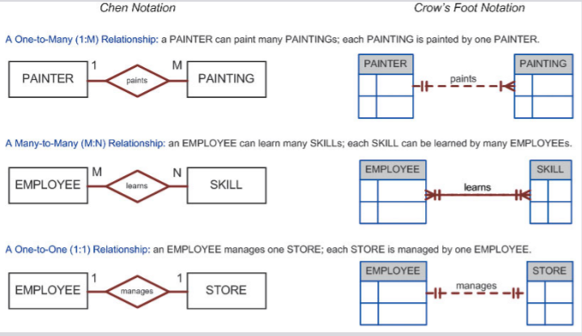
2 Notations - ERD
DATA MODELS
Sudha Bhagavatheeswaran, Department of Information Technology,
SIES College of Arts, Science & Commerce (Autonomous)

Slide 7
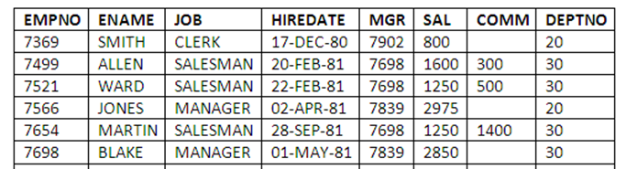
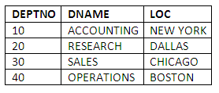
DATA MODEL BASIC BUILDING BLOCKS – Example (Find RACE)
DATA MODELS
Entity - EMPLOYEE,DEPARTMENT
Attributes – For EMPLOYEE, EMPNO,ENAME,JOB………..For DEPARTMENT , DEPTNO,DNAME,LOC
Relationship – EMPLOYEE to DEPARTMENT - Many to one , DEPARTMENT to EMPLOYEE – One to Many
Constraint - An employee’s salary must have values that are between 6,000 and 350,000.
PRIMARY KEY
FOREIGN KEY
PRIMARY KEY
EMPLOYEE
DEPARTMENT
Sudha Bhagavatheeswaran, Department of Information Technology,
SIES College of Arts, Science & Commerce (Autonomous)

Slide 8
BUSINESS RULES
DATA MODELS
A business rule is a brief, precise, and unambiguous description of a policy, procedure, or principle within a specific organization.
Business rules, derived from a detailed description of an organization’s operations, help to create and enforce actions within that organization’s environment. Business rules must be rendered in writing and updated to reflect any change in the organization’s operational environment.
Business rules describe, in simple language, the main and distinguishing characteristics of the data as viewed by the company.
Examples of business rules are as follows: A customer may generate many invoices. An invoice is generated by only one customer. A training session cannot be scheduled for fewer than 10 employees or for more than 30 employees.
Business rules establish entities, relationships, and constraints
Sudha Bhagavatheeswaran, Department of Information Technology,
SIES College of Arts, Science & Commerce (Autonomous)

Slide 9
TRANSLATING BUSINESS RULES INTO DATA MODEL COMPONENTS
DATA MODELS
Business rule “a customer may generate many invoices”
  contains two nouns (customer and invoices) and a verb (generate) that associates the nouns.
  Customer and invoice are objects of interest for the environment and should be represented by their respective entities. There is a “generate” relationship between customer and invoice.
To properly identify the type of relationship, you should consider that relationships are bidirectional; that is, they go both ways.
For example, the business rule “a customer may generate many invoices” is complemented by the business rule “an invoice is generated by only one customer.”
In that case, the relationship is one-to-many (1:M). Customer is the “1” side, and invoice is the “many” side.
Sudha Bhagavatheeswaran, Department of Information Technology,
SIES College of Arts, Science & Commerce (Autonomous)

Slide 10
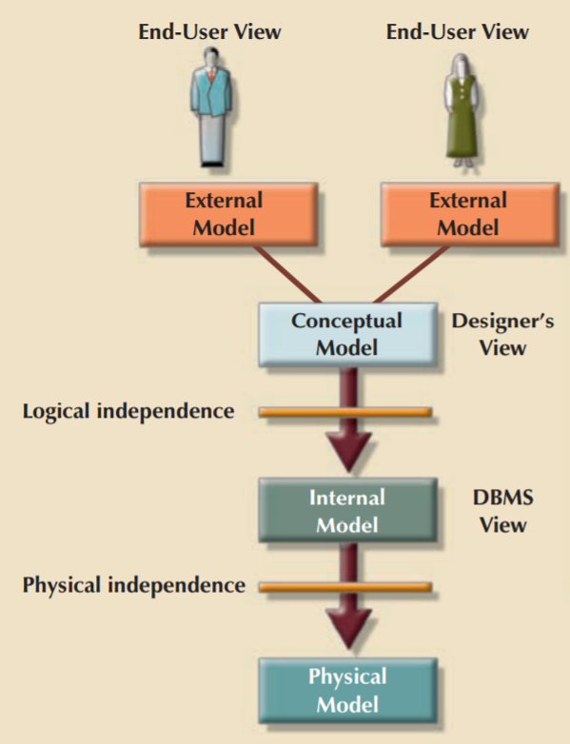
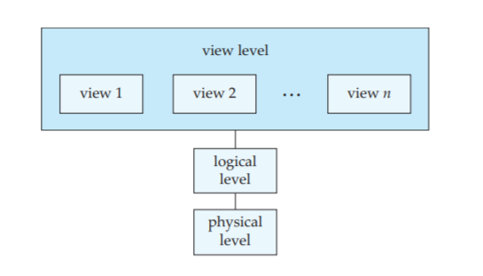
DEGREES OF DATA ABSTRACTION
DATA MODELS
EXTERNAL MODEL
CONCEPTUAL MODEL
INTERNAL MODEL
PHYSICAL MODEL
Sudha Bhagavatheeswaran, Department of Information Technology,
SIES College of Arts, Science & Commerce (Autonomous)

Slide 11
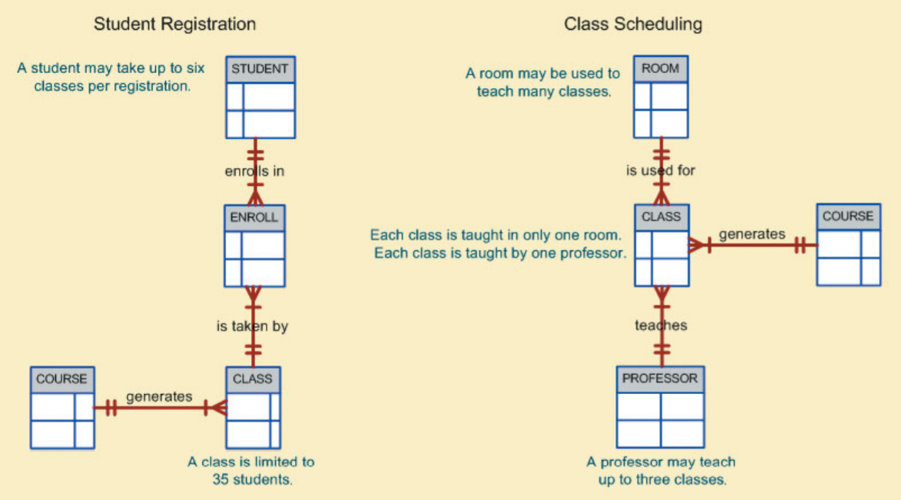
EXTERNAL MODEL
DATA MODELS
The external model is the end users’ view of the data environment.
The term end users refers to people who use the application programs to manipulate the data and generate information.
A specific representation of an external view is known as an external schema
Sudha Bhagavatheeswaran, Department of Information Technology,
SIES College of Arts, Science & Commerce (Autonomous)

Slide 12
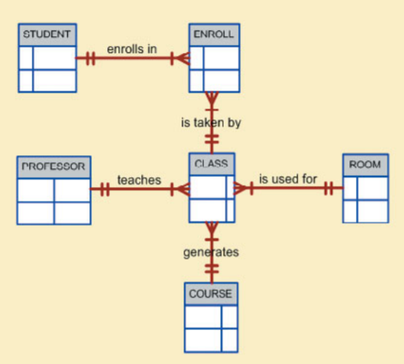
CONCEPTUAL MODEL
DATA MODELS
CONCEPTUAL MODEL :- (Logical Design) is used to integrate all external views into a single view.
The conceptual model represents a global view of the entire database as viewed by the entire organization. Also known as a conceptual schema.
The conceptual model is independent of both software and hardware
CONCEPTUAL MODEL
EXTERNAL MODEL
Sudha Bhagavatheeswaran, Department of Information Technology,
SIES College of Arts, Science & Commerce (Autonomous)

Slide 13
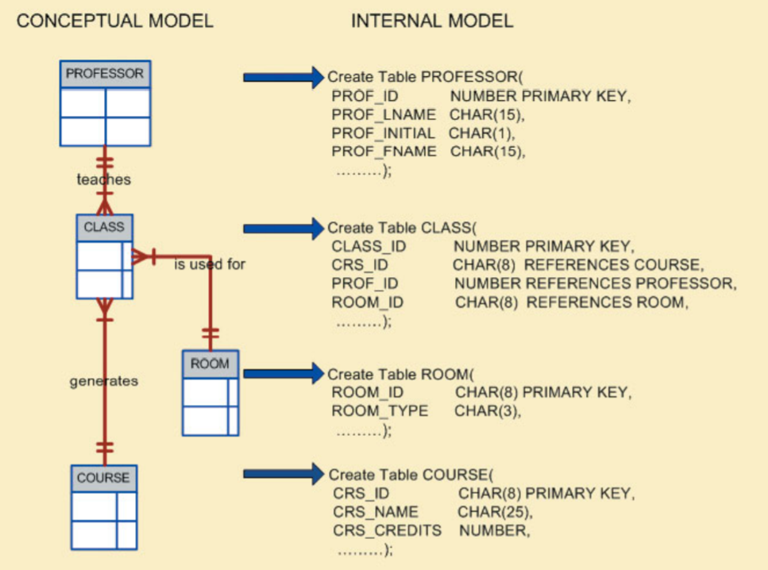
inTERNAL MODEL
DATA MODELS
The internal model is the representation of the database as “seen” by the DBMS.
The internal model requires the designer to match the conceptual model’s characteristics and constraints to those of the selected implementation model.
An internal schema depicts a specific representation of an internal model, using the database constructs supported by the chosen database.
The internal model depends on specific database software, it is said to be software-dependent. the internal model is still hardware-independent.
Sudha Bhagavatheeswaran, Department of Information Technology,
SIES College of Arts, Science & Commerce (Autonomous)

Slide 14
PHYSICAL MODEL
DATA MODELS
PHYSICAL MODEL.:- The physical model operates at the lowest level of abstraction, describing the way data are saved on storage media such as disks or tapes.
The physical model requires the definition of both the physical storage devices and the (physical) access methods required to reach the data within those storage devices, making it both software- and hardware dependent.
Sudha Bhagavatheeswaran, Department of Information Technology,
SIES College of Arts, Science & Commerce (Autonomous)

Slide 15
DEGREES OF DATA ABSTRACTION
DATA MODELS
Logical Independence
When you can change the internal model without affecting the conceptual model, you have logical independence
Physical Independence
When you can change the physical model without affecting the internal model, you have physical independence
Sudha Bhagavatheeswaran, Department of Information Technology,
SIES College of Arts, Science & Commerce (Autonomous)

Slide 16
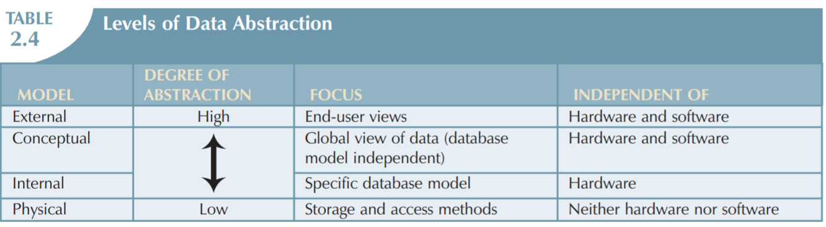
DEGREES OF DATA ABSTRACTION
DATA MODELS
Sudha Bhagavatheeswaran, Department of Information Technology,
SIES College of Arts, Science & Commerce (Autonomous)

Slide 17
CHAPTER 2 ENDS…….
DATA MODELS
WHAT WE COVERED……
What is a data model?
Importance of data model
Data model Basic building blocks (RACE)
2 notations of ERD
What is a Business Rule?
Translating business rules into data model components
Degrees of data abstraction (4 Models)
Sudha Bhagavatheeswaran, Department of Information Technology,
SIES College of Arts, Science & Commerce (Autonomous)

